Slide 1
OpenDSS Training Workshop
University of Puerto Rico - Mayaguez
Roger C. Dugan
Sr. Technical Executive
EPRI Knoxville, TN
January 21-22, 2019

Slide 2
6. Intro to OpenDSS Parallel Machine
Version 8

Slide 3


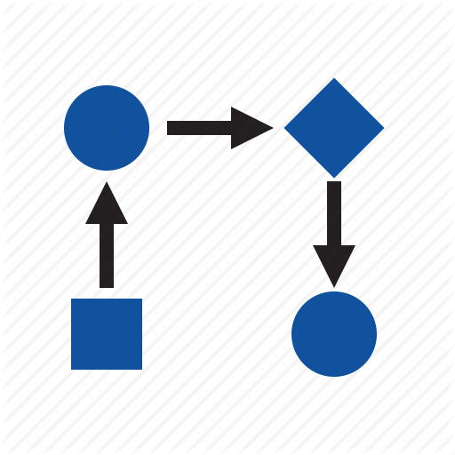

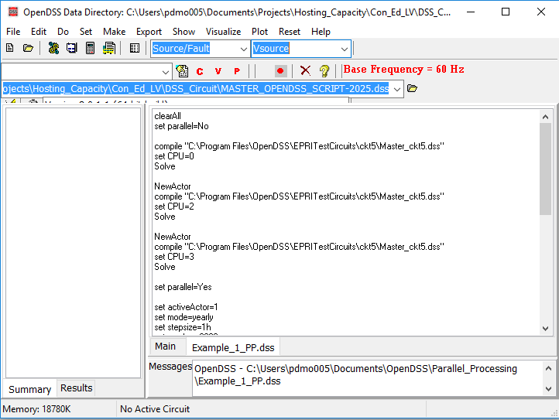
The evolution of OpenDSS into a parallel computing machine
After being released in 2008 as open source software OpenDSS has become widely used around the world. One of the features that makes OpenDSS popular is that the package offers interfaces for co-simulation.

Slide 4
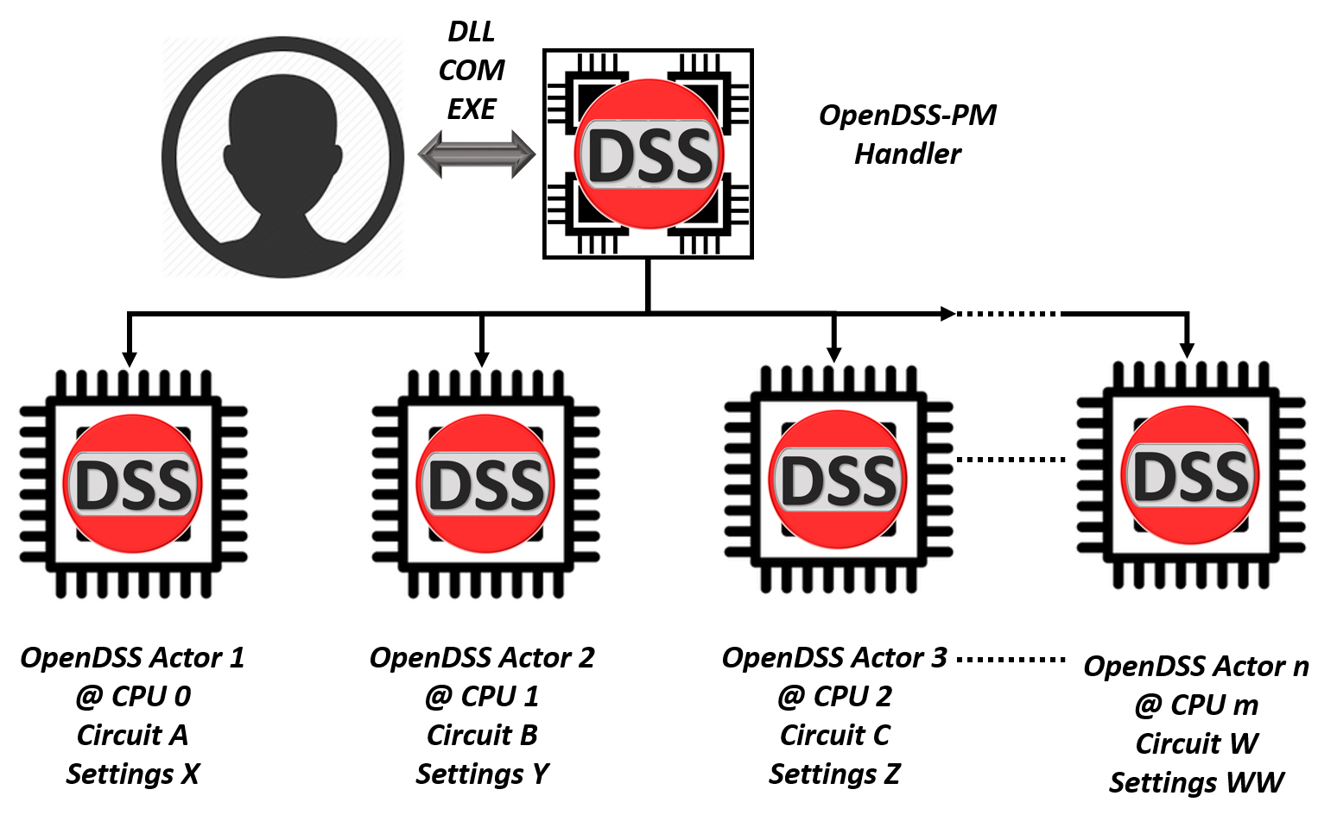
The evolution of OpenDSS into a parallel computing machine

Slide 5
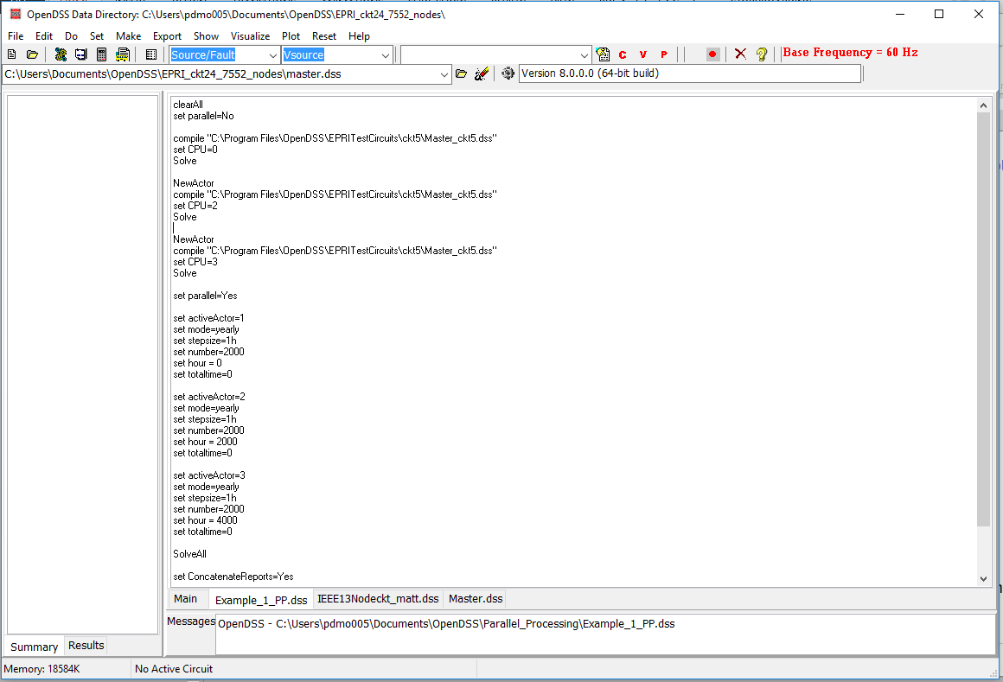

The evolution of OpenDSS into a parallel computing machine
These features have been implemented into the existing interfaces preserving the format and adding instructions to the instruction set

Slide 6
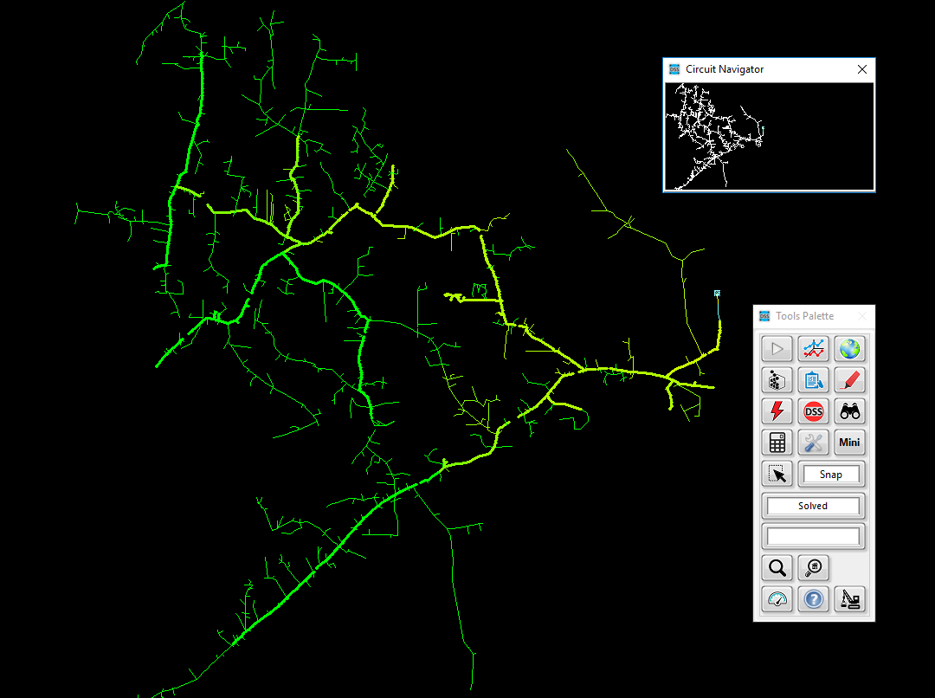


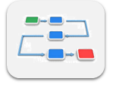


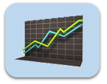

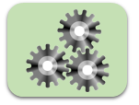


The evolution of OpenDSS into a parallel computing machine
TCP/IP Server
OpenDSS-G
Dbus

Slide 7
The evolution of OpenDSS into a parallel computing machine
There is a new set of functions and instructions related with parallel processing, topology analysis and more that can be used using the same DSS command environment
NumCPUs | ClearAll | Tear_Circuit
NumCores | Wait | Export IncMatrix
NewActor | Parallel | Export IncMatrixRows
NumActors | SolveAll | Export IncMatrixCols
ActiveActor | ConcatenateReports | Export BusLevels
CPU | CalcIncMatrix | Init_Diakoptics
ActorProgress | CalcIncMatrix_o | Refine_BusLevels
Abort | CalcLaplacian | Export Laplacian

Slide 8
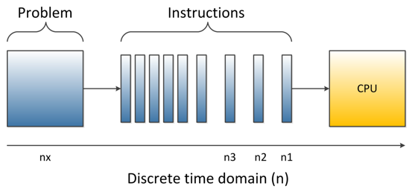
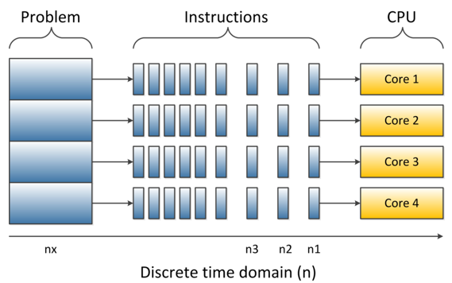
How far can you get with your computer in multi-core
Depending on your computer features and the understanding that you have about them it will depend how far can you go with parallel processing

Slide 9
How far can you get with your computer in multi-core
Thread 0 (CPU)
Core
Thread 1 (CPU)
Depending on your computer features and the understanding that you have about them it will depend how far can you go with parallel processing

Slide 10
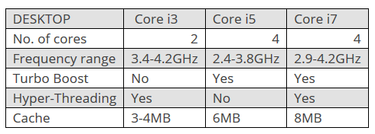

How far can you get with your computer in multi-core
CPU 1
CPU 0
Core
http://www.trustedreviews.com/opinion/best-intel-processor-core-i3-i5-i7-2937692
Depending on your computer features and the understanding that you have about them it will depend how far can you go with parallel processing

Slide 11
How far can you get with your computer in multi-core
CPU 0
Core
CPU 0
CPU 1
CPU 2
Core
CPU 2
CPU 3
Depending on your computer features and the understanding that you have about them it will depend how far can you go with parallel processing

Slide 12
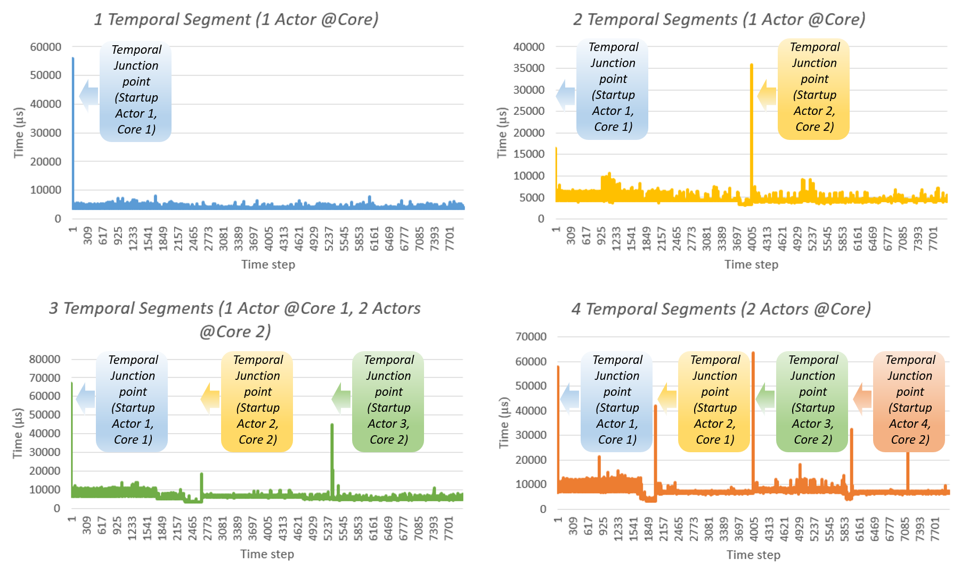
Parallel processing in OpenDSS What can I do with it?
Temporal Parallelization

Slide 13
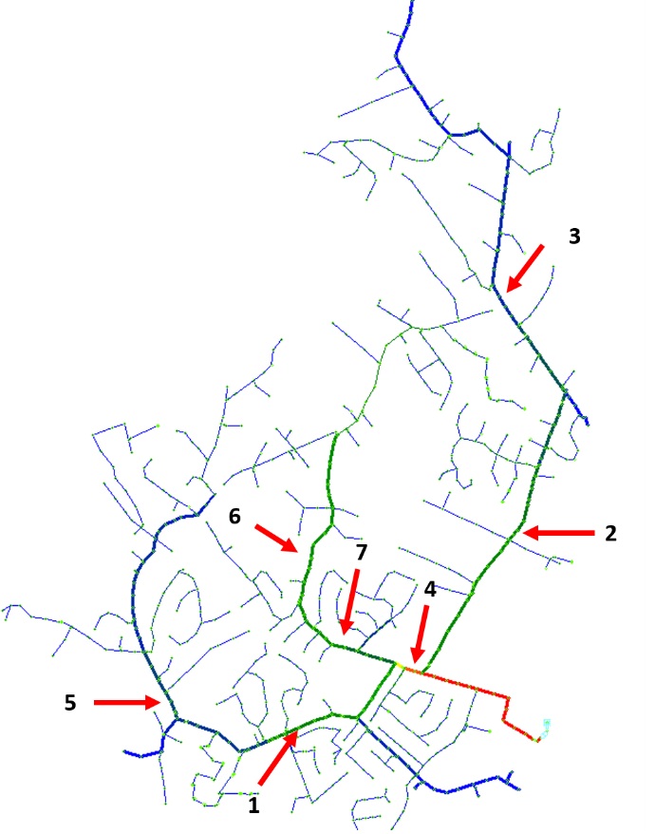
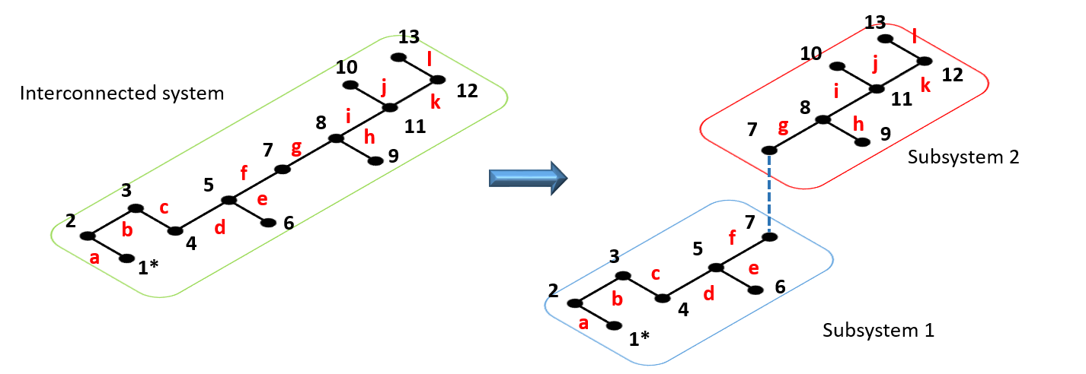
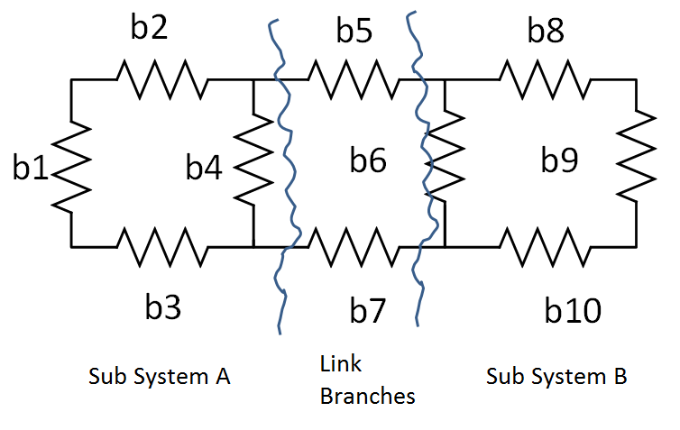
Parallel processing in OpenDSS What can I do with it?
Spatial Parallelization

Slide 14
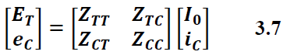
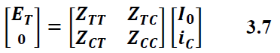
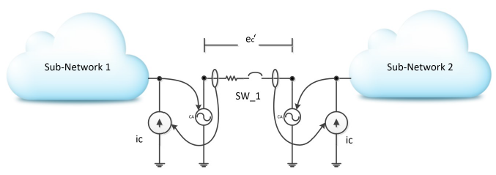
Actor based Diakoptics (A-Diakoptics)
Notes:
Remember to compare with slide 23.

Slide 15
Basics of A-Diakoptics
Diakoptics proposed by G. Kron in the 50’s.
Authors have used it for interconnecting independent system in several domains.
H. Happ proposed a systematic approach based on the Z matrix (Z-Diakoptics).
This approach was initially conceived was to cover systems with multiple excitations.
Notes:
Remember to compare with slide 23.

Slide 16
However, the time has passed
There are modern methods to solve the power flow problem…
This strategy can be used to generate several solvers working together concurrently…
Each primitive can be solved independently…
This means that the reference vector (currents) will change during the solving process…
Notes:
Remember to compare with slide 23.

Slide 17
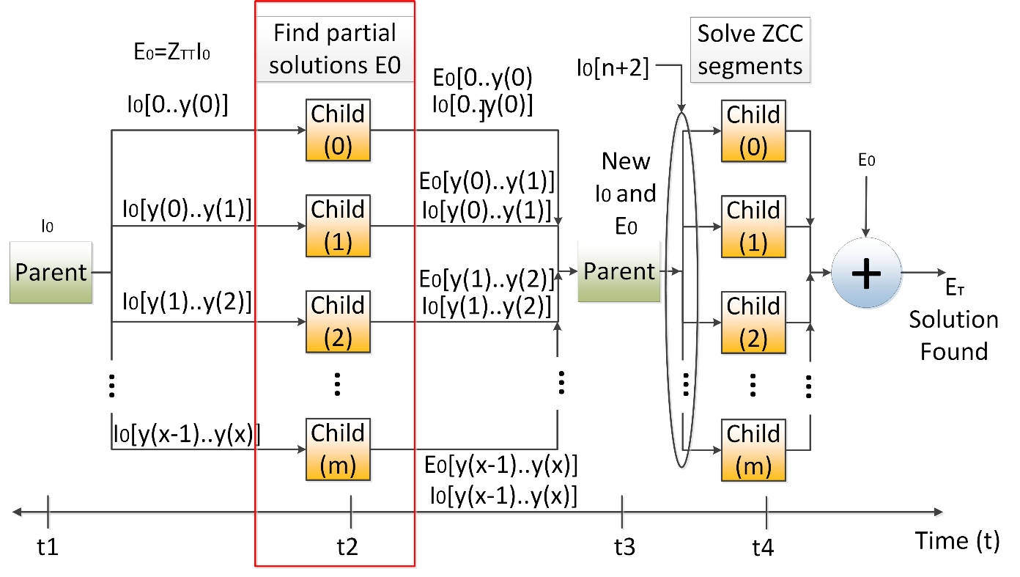
Multilevel A-Diakoptics
“Multilevel A-Diakoptics for the Dynamic Power Flow Simulation of Hybrid Power Distribution Systems”. D. Montenegro, G. Ramos, S. Bacha.
IEEE Transactions on Industrial Informatics.
“Iterative method for detecting and localizing islands within sparse matrixes using DSSim-RT”. D. Montenegro, G. Ramos.
IEEE PEPQA 2015.
Notes:
Remember to compare with slide 23.

Slide 18
Starting a parallel computing simulation
clearAll
set parallel=No
! Starts with Actor 1
compile "C:\Program Files\OpenDSS\EPRITestCircuits\ckt5\Master_ckt5.dss"
set CPU=0
Solve
NewActor ! Creates Actor 2 and activates it
compile "C:\Program Files\OpenDSS\EPRITestCircuits\ckt5\Master_ckt5.dss"
set CPU=2
Solve
NewActor ! Creates Actor 3 and activates it
compile "C:\Program Files\OpenDSS\EPRITestCircuits\ckt5\Master_ckt5.dss"
set CPU=3
Solve
set parallel=Yes
…

Slide 19
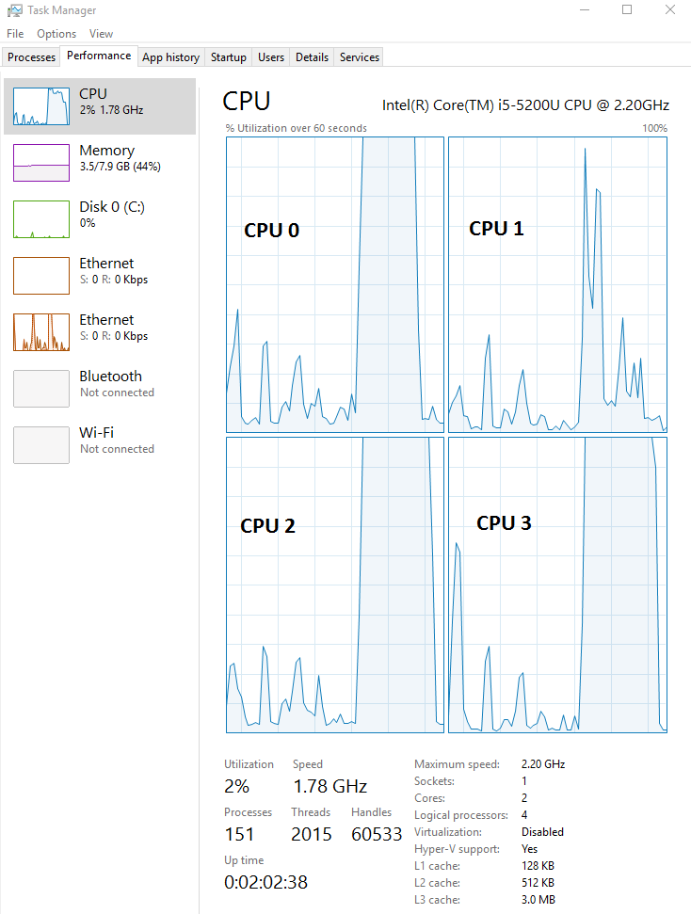
Starting a parallel computing simulation
…
set activeActor=1
set mode=yearly stepsize=1h number=2000 hour = 0 totaltime=0
set activeActor=2
set mode=yearly stepsize=1h number=2000 hour = 2000 totaltime=0
set activeActor=3
set mode=yearly stepsize=1h number=2000 hour = 4000 totaltime=0
SolveAll
Wait
set ConcatenateReports=Yes
show monitor MS2

Slide 20
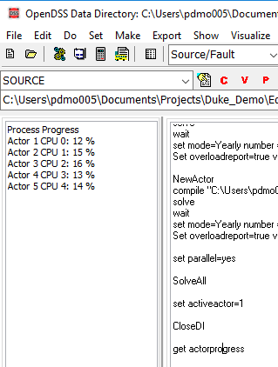
Parallel in OpenDSS means concurrently
…
set activeActor=1
set mode=yearly stepsize=1h number=2000 hour = 0 totaltime=0
set activeActor=2
set mode=yearly stepsize=1h number=2000 hour = 2000 totaltime=0
set activeActor=3
set mode=yearly stepsize=1h number=2000 hour = 4000 totaltime=0
SolveAll
get actorprogress

Slide 21
Parallel in OpenDSS means concurrently
…
set activeActor=1
set mode=yearly stepsize=1h number=2000 hour = 0 totaltime=0
set activeActor=2
set mode=yearly stepsize=1h number=2000 hour = 2000 totaltime=0
set activeActor=3
set mode=yearly stepsize=1h number=2000 hour = 4000 totaltime=0
SolveAll
Wait
set ConcatenateReports=No
set activeActor=1
show monitor MS2
set activeActor=2
show monitor MS2 …

Slide 22
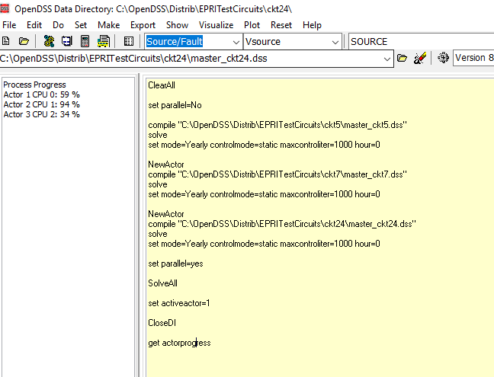
Parallel in OpenDSS means concurrently

Slide 23
Parallel processing in OpenDSS using COM
The examples for parallel processing can be downloaded from:
https://sourceforge.net/p/electricdss/code/HEAD/tree/trunk/Version8/Distrib/Examples/Parallel_Processing
These examples involves MATLAB and python.
Other examples for LabVIEW through the VI Package Manager

Slide 24
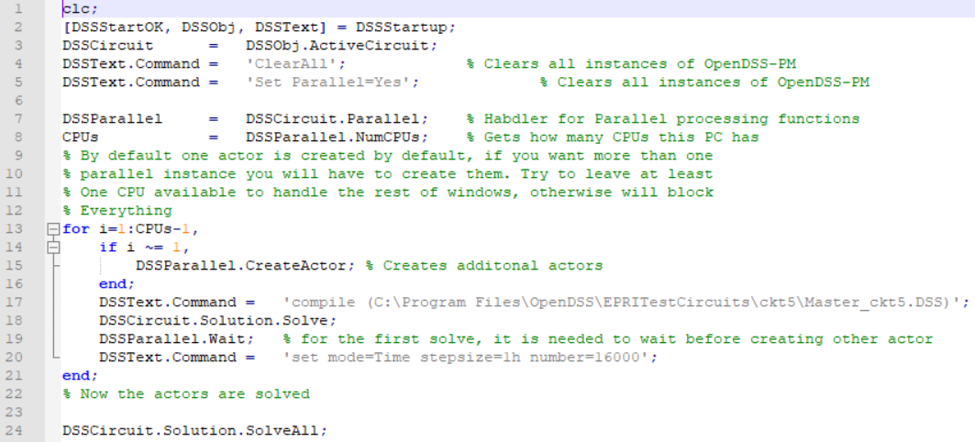
Parallel processing in OpenDSS using COM
Example # 1 MATLAB

Slide 25
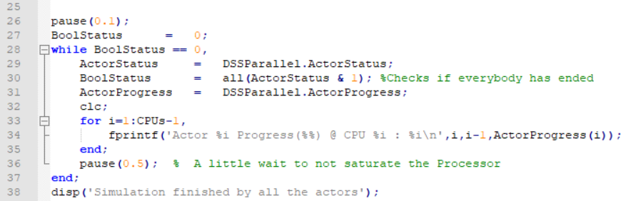
Parallel processing in OpenDSS using COM
Example # 1 MATLAB

Slide 26
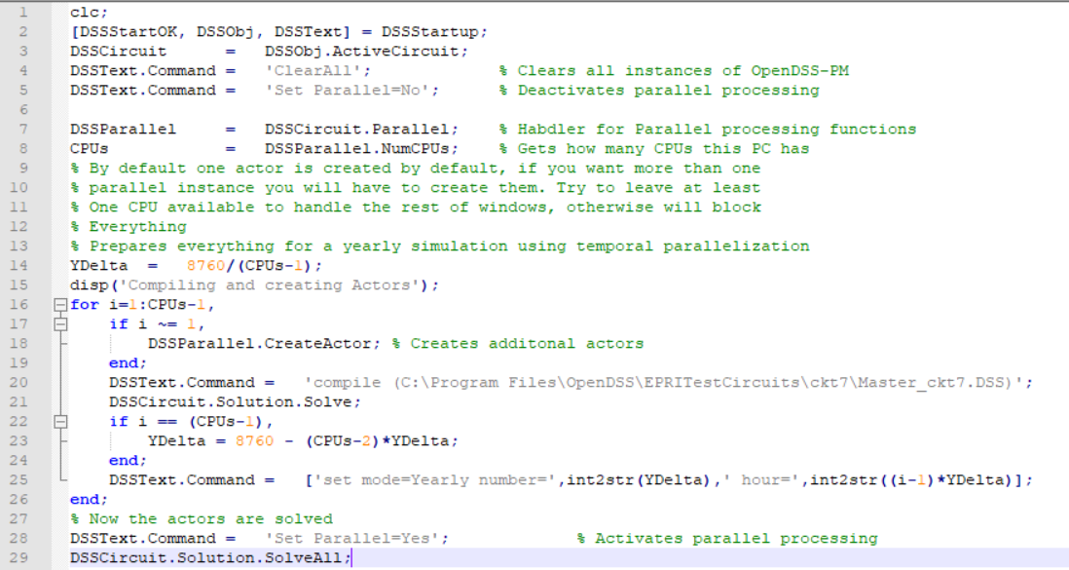
Parallel processing in OpenDSS using COM
Example # 2 MATLAB

Slide 27
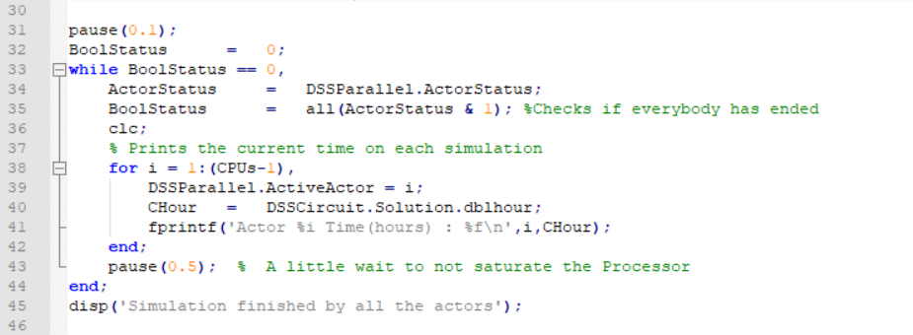
Parallel processing in OpenDSS using COM
Example # 2 MATLAB

Slide 28
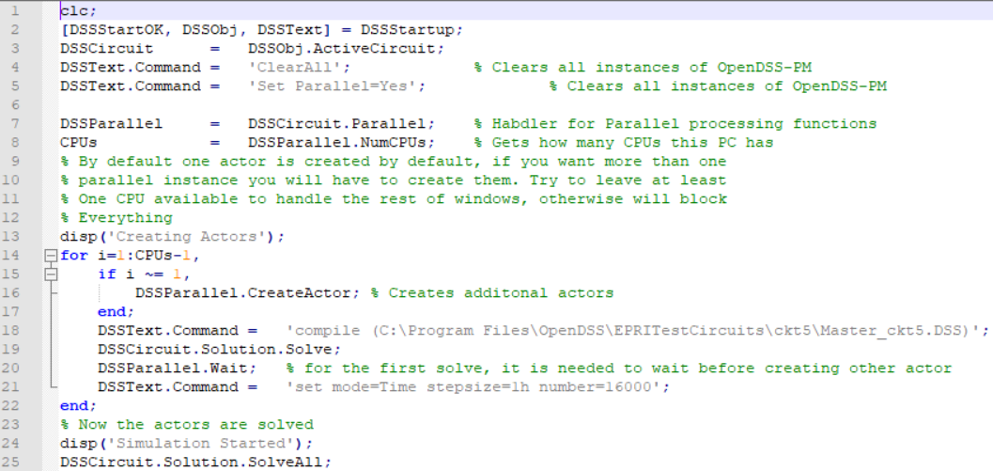
Parallel processing in OpenDSS using COM
Example # 3 MATLAB

Slide 29
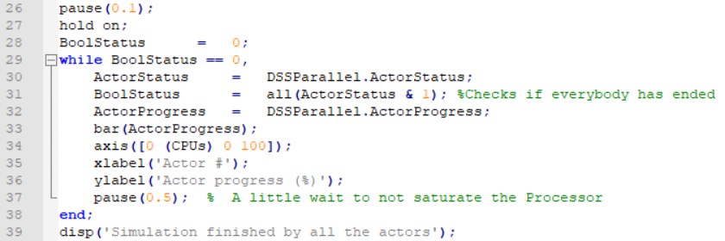
Parallel processing in OpenDSS using COM
Example # 3 MATLAB

Slide 30
Complementary Tools
https://epri.box.com/s/o4itfn23txv73iyo3y1ukbs9nmgsspgo

Slide 31
Advanced Graphics Module for OpenDSS (OpenDSS-Viewer)
Developed by Miguel Hernandez (EPRI). Enhance the visualization of Distribution System Simulations with a flexible, scalable and meaningful approach.
https://epri.box.com/s/o4itfn23txv73iyo3y1ukbs9nmgsspgo

Slide 32
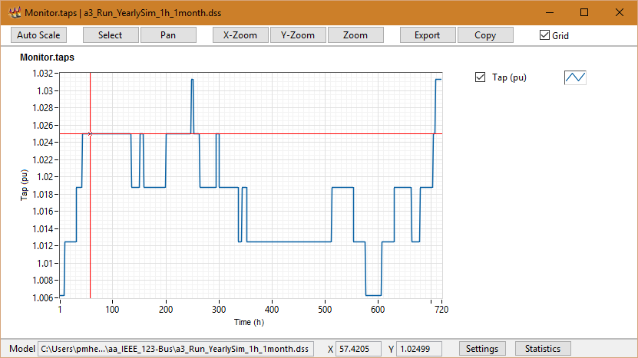
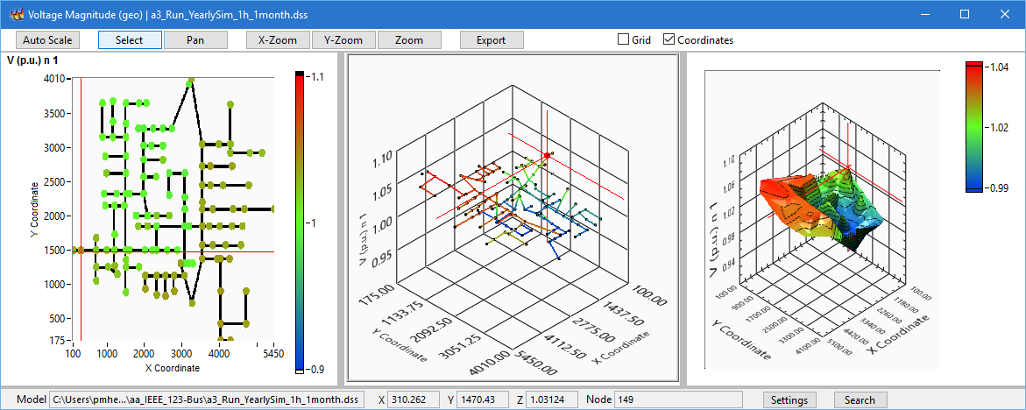
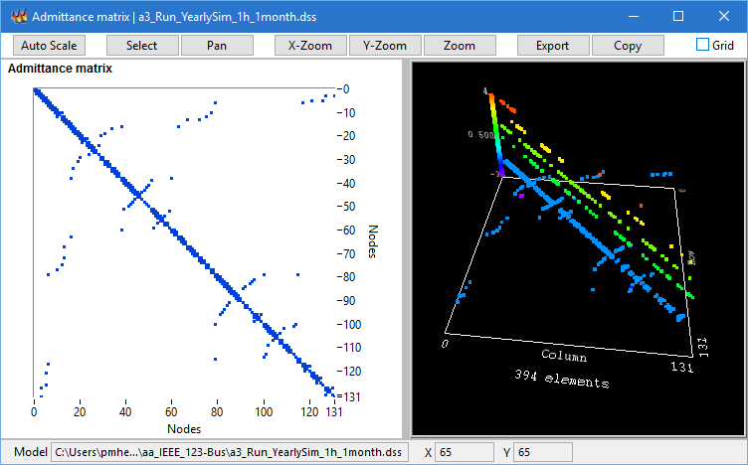
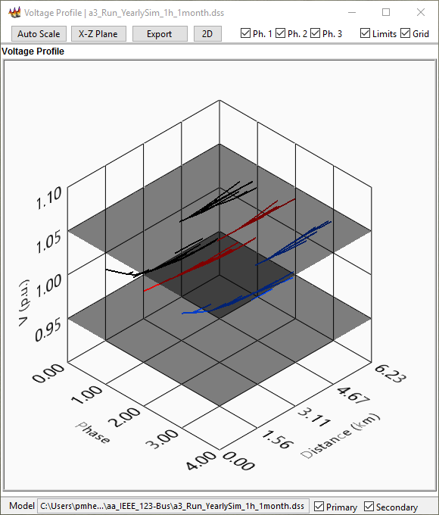
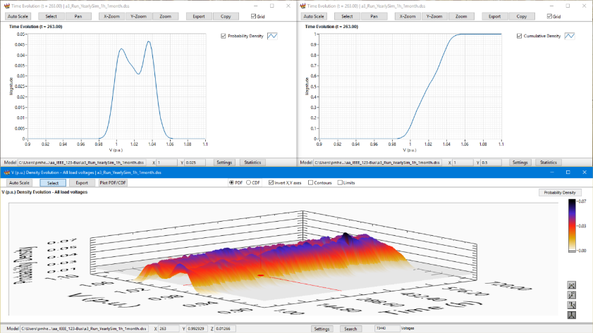
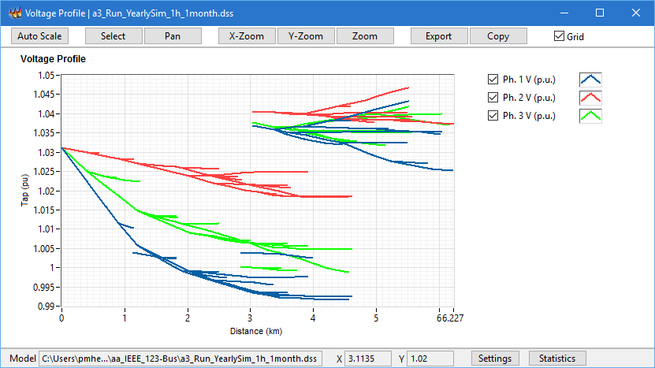
Complementary Tools

